Slide 1
MRNet MRI Classification for ACL Injury Detection
Authors: Cameron Rader, Suneil Patel, Babita Babita, Ali Behbani, Pablo Castrejon
Team 15

Slide 2
Contents
1
Introduction
2
Motivation
3
Technical Approach
4
Baseline Selection
5
Baseline Implementation
6
Model Improvements and Future Work

Slide 3
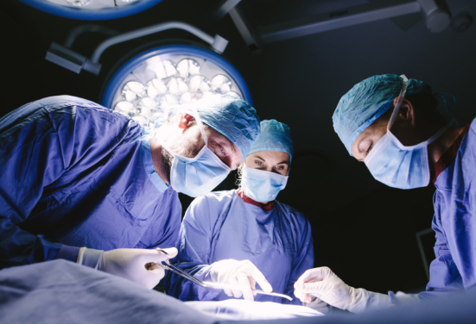
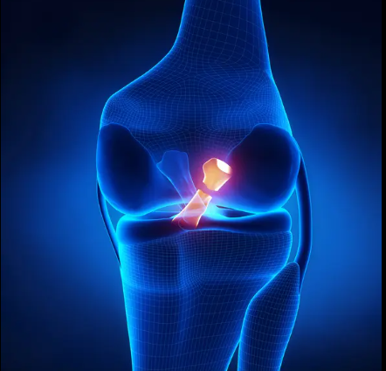
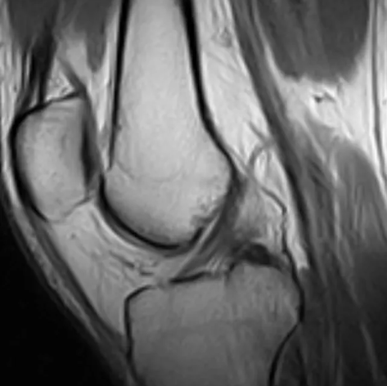
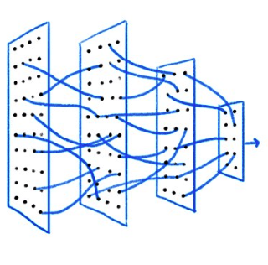
Overview
About 400,000 ACL-related knee reconstructions are performed annually in the U.S.
ACL injuries are marked by cracks, with MRI being the most accurate diagnostic tool.
MRI can detect ligament cracks, but diagnosis still relies on radiologist expertise.
Goal: Develop a deep learning model to classify ACL tears, meniscal tears, and general abnormalities from knee MRI scans.

Slide 4
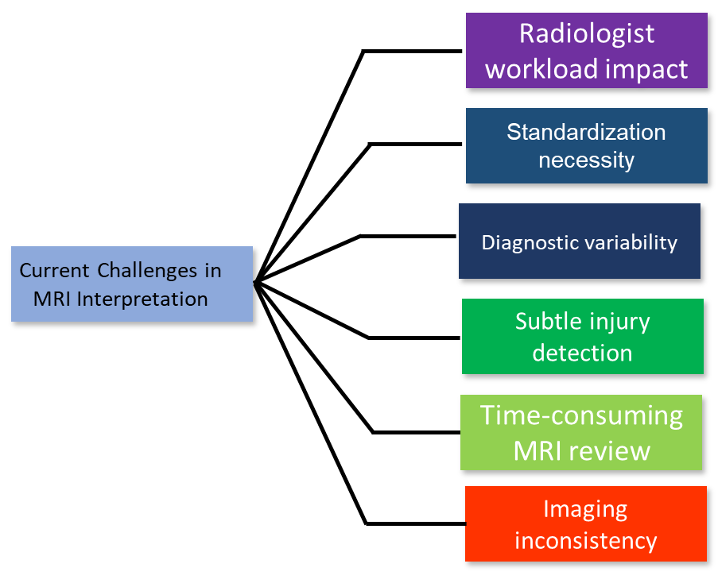
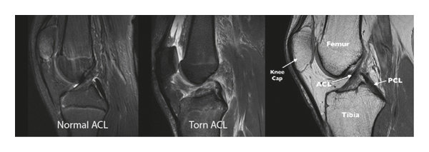
Background
Knee MRI scans are vital for diagnosing ACL injuries, but manual interpretation presents significant challenges, driving the need for AI solutions.
Technological Intergration Benefits
Faster ACL injury diagnosis
Reduce human interpretation error
Standardizes MRI analysis
Image: Difference between normal and torn ACL in MRI.
Journal of Healthcare Engineering, vol. 2022, Article ID 7872500, 2022

Slide 5

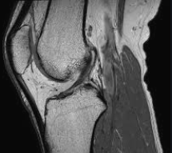
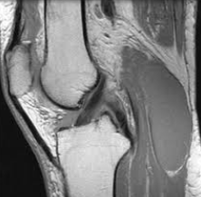
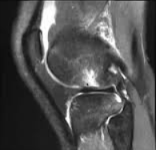

Dataset Description:
Magnetic Resonance Network Dataset MRNet:
It contains 1,370 knee MRI exams from real patients.
Structure: Each exam has three MRI view series
Axial
Sagittal
Coronal
Labels: Each exam is labeled for either:
ACL Tear
Meniscal Tears
General Abnormalities

Slide 6
2.3 Data Preprocessing Techniques
Volume/Slice Standardization:
Ensure consistent input (Slices x Height x Width) format across all MRI volumes
Min-Max normalize each slice individually to range [0,1]
Feature Extractor formatting consistency:
Resize all slices to 224x224 pixels to match the input size required for (ex. Resnet18)
Convert single channel grayscale slices into 3-channel RGB format by replicating the grayscale across 3 channels
Normalize pixel values using ImageNet mean and standard deviation to align with pretrained CNN expectations
Memory Management:
Center-crop or pad MRI volumes to a maximum of 32 slices, creating uniform batch shapes and managing input sample size

Slide 7
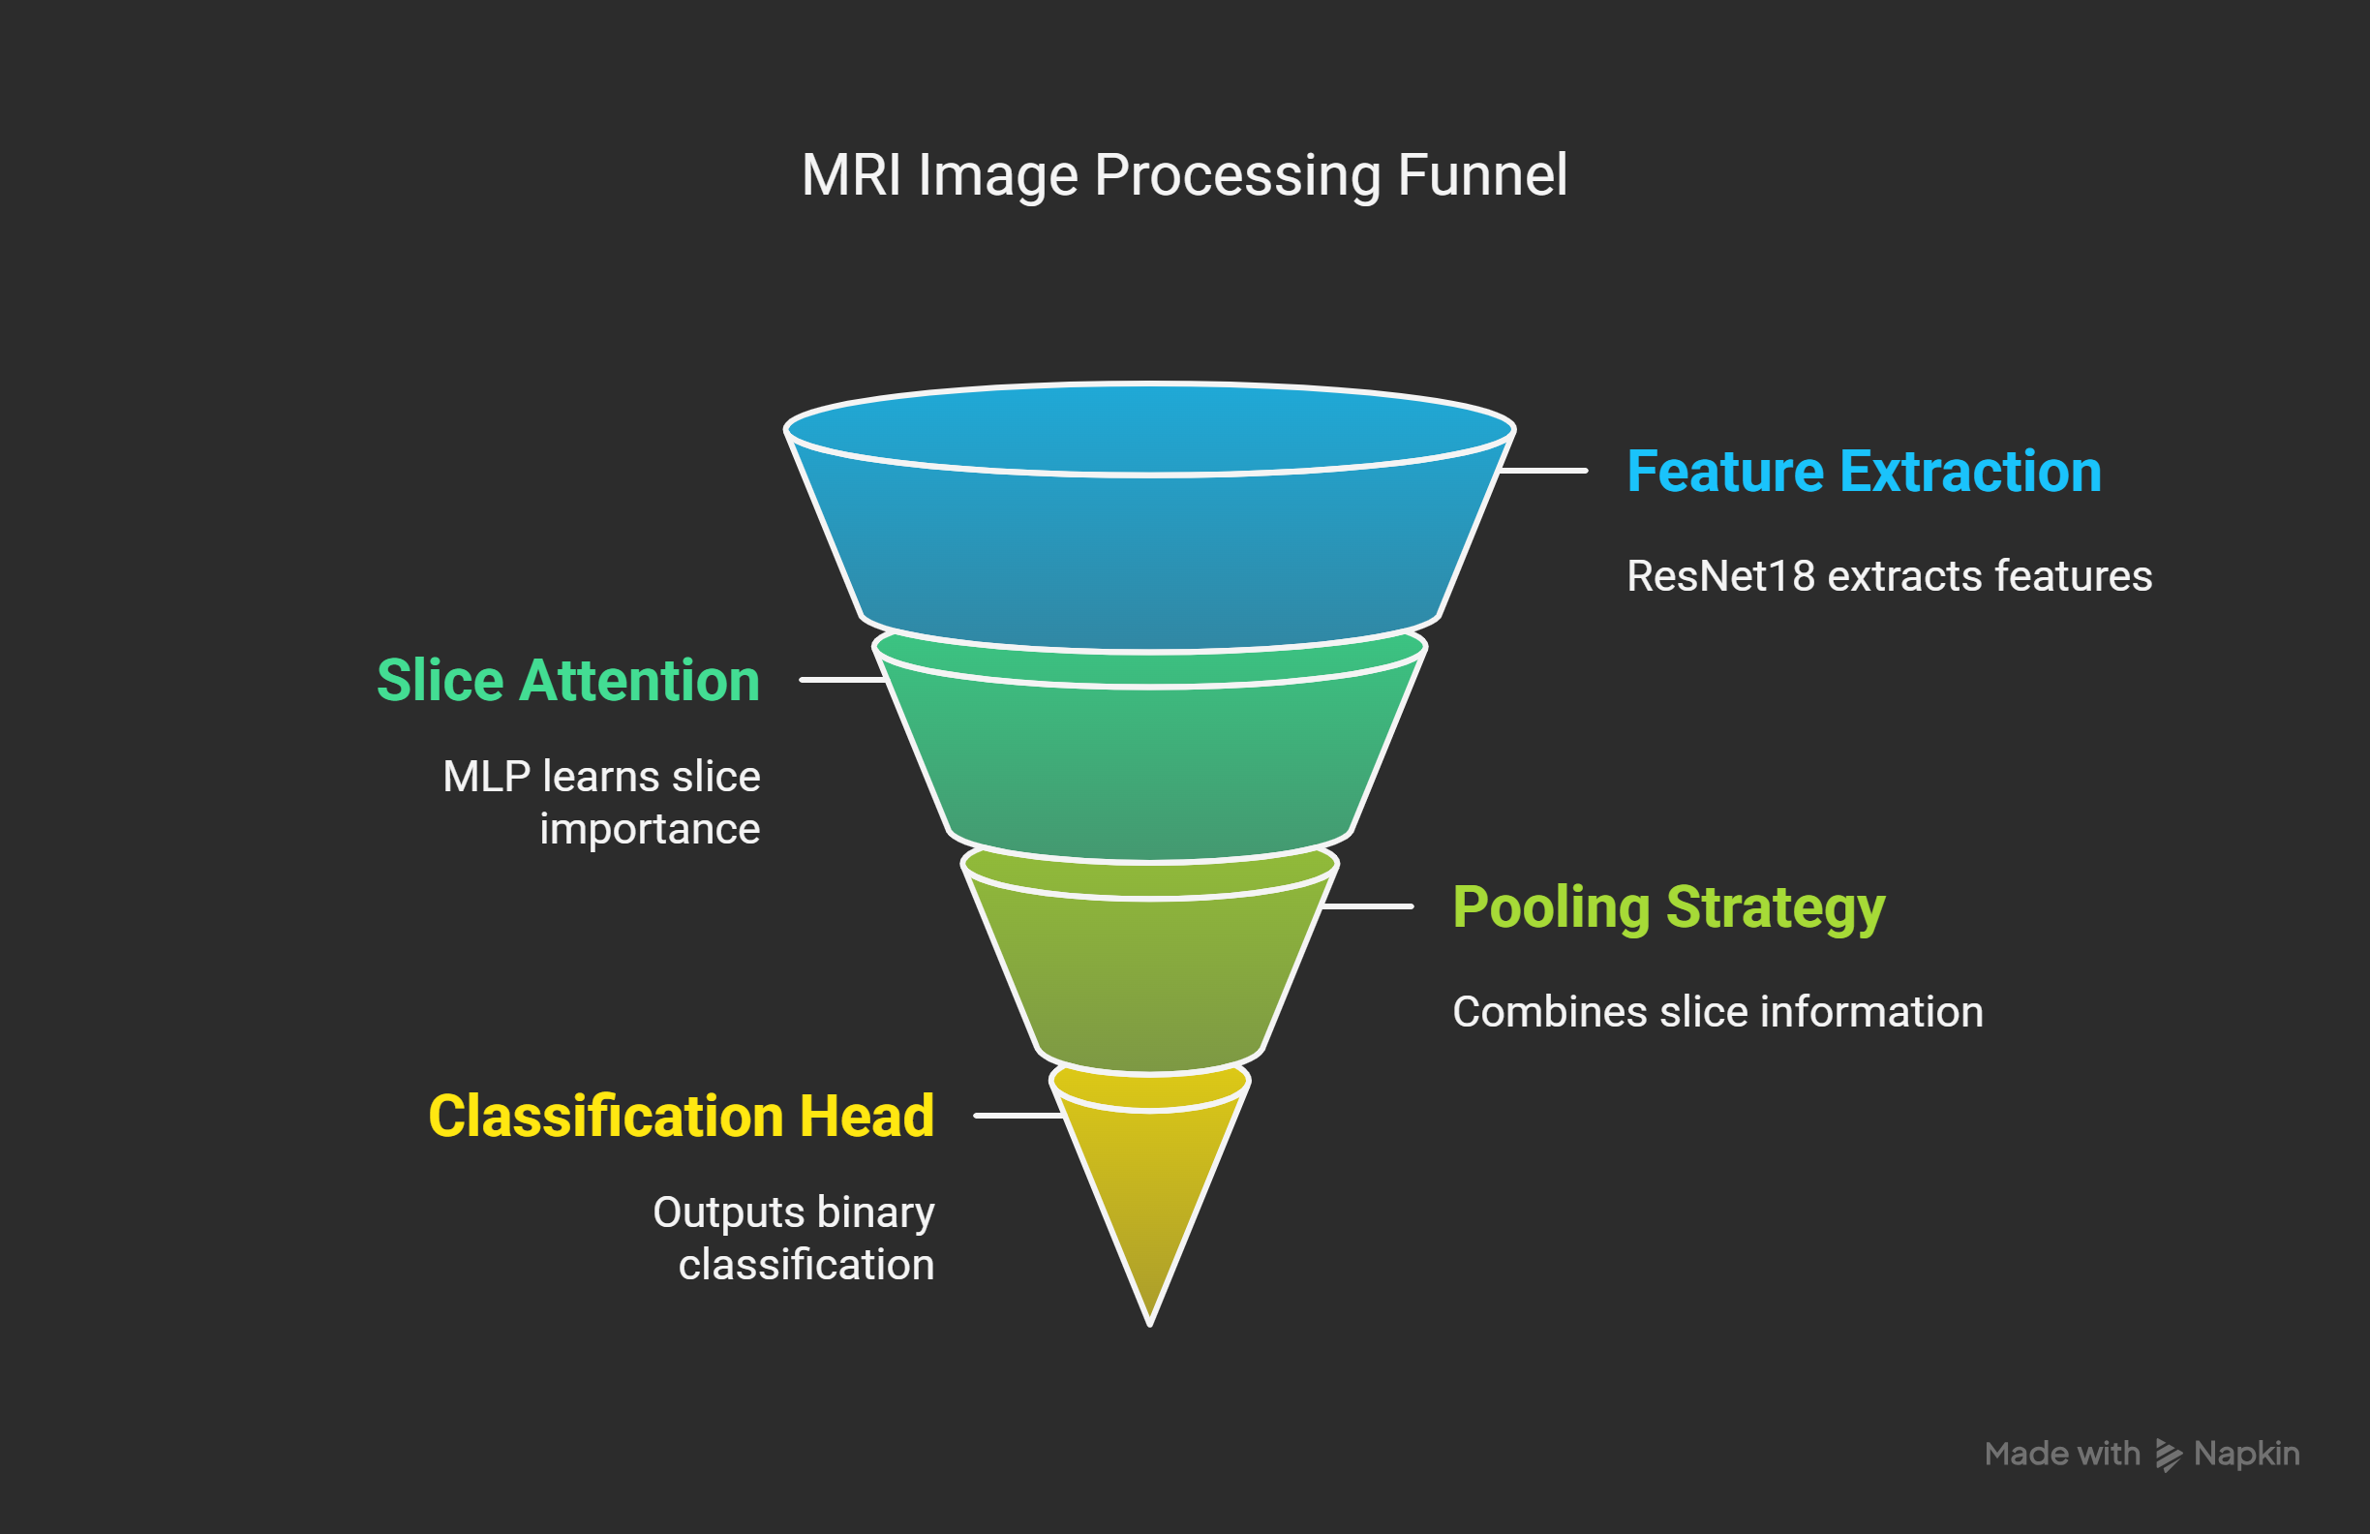
Final Pipeline: Model Architecture
1. Backbone Network
ResNet18 pretrained on ImageNet
Extracts features from individual MRI slices
2. Slice Attention Mechanism
MRI slices can contain noise and irrelevant information
Small MLP learns importance weights across slices
(Linear → Tanh → Dropout → Linear)
3. Pooling Strategy
Max Pooling: Focuses on strongest slice, but may be noisy
Mean Pooling: Averages all slices, but dilutes strong signals
Chosen: Mean-Max Pooling: Combines sharpness of max and robustness of mean for richer summaries
4. Classification Head
Fully connected layers with BatchNorm, Dropout, and ReLU activation
Final output: Single neuron (binary classification)

Slide 8
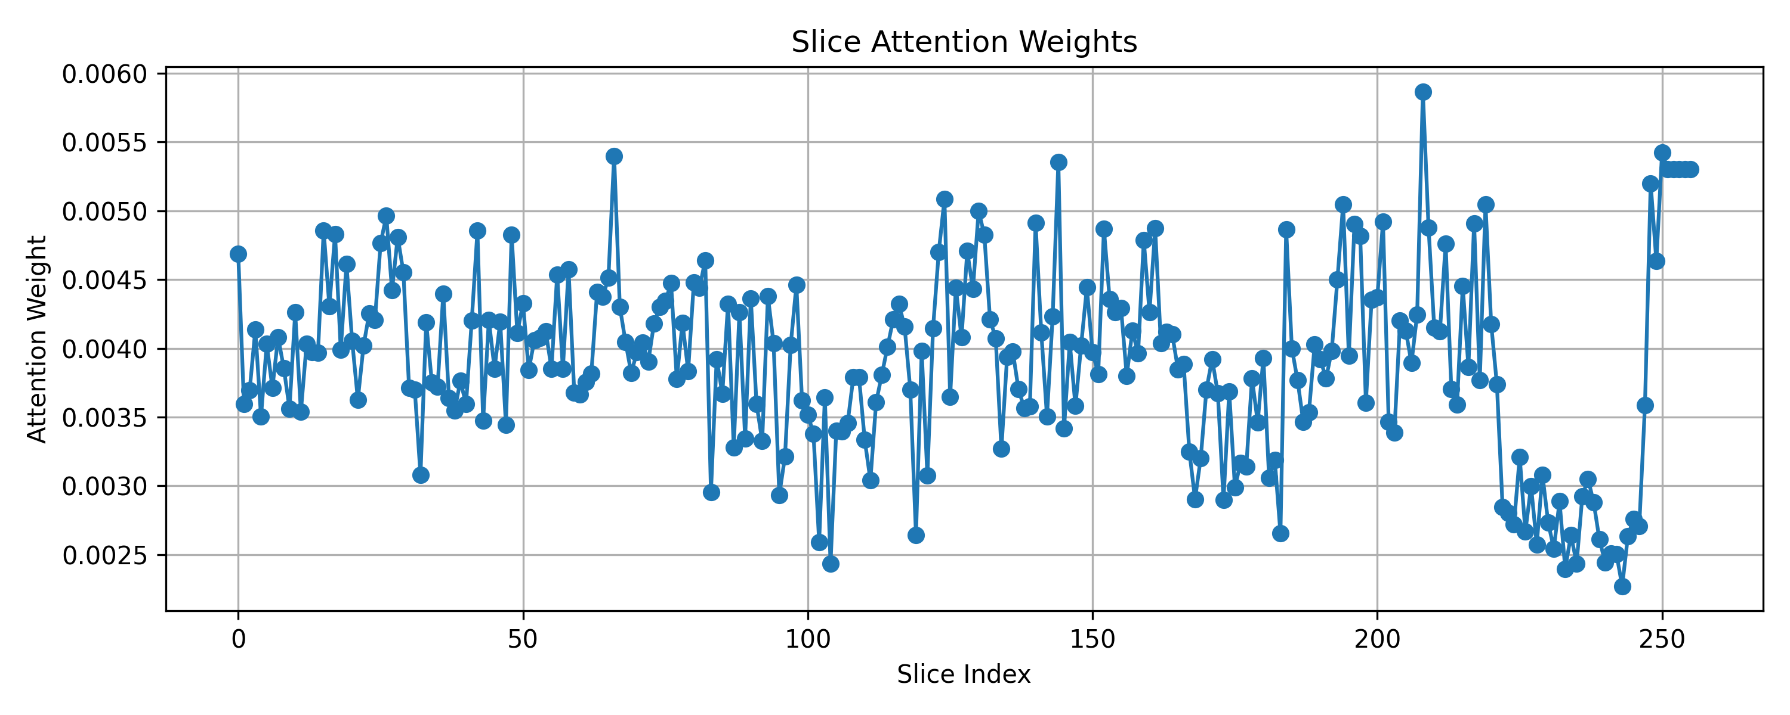
Attention Visualization

Slide 9
Final Pipeline: Training strategy
Training
Overfitting Mitigation
Optimizer
AdamW with weight decay for regularization
Learning Rate Scheduler
OneCycleLR with differential rates:
Lower LR for CNN backbone
Higher LR for classification head
Loss Function
Binary Cross-Entropy with Logits Loss (BCEWithLogitsLoss)
Optional positive class weighting to handle class imbalance
Progressive Backbone Unfreezing
0-30% epochs: Backbone frozen
30-70% epochs: Top 70% of backbone layers unfrozen
70-100% of epochs: Full backbone unfrozen
Data Augmentation Scheduler:
Clean data -> Strong Augmentations -> Clean data (Fine-tuning phase)

Slide 10
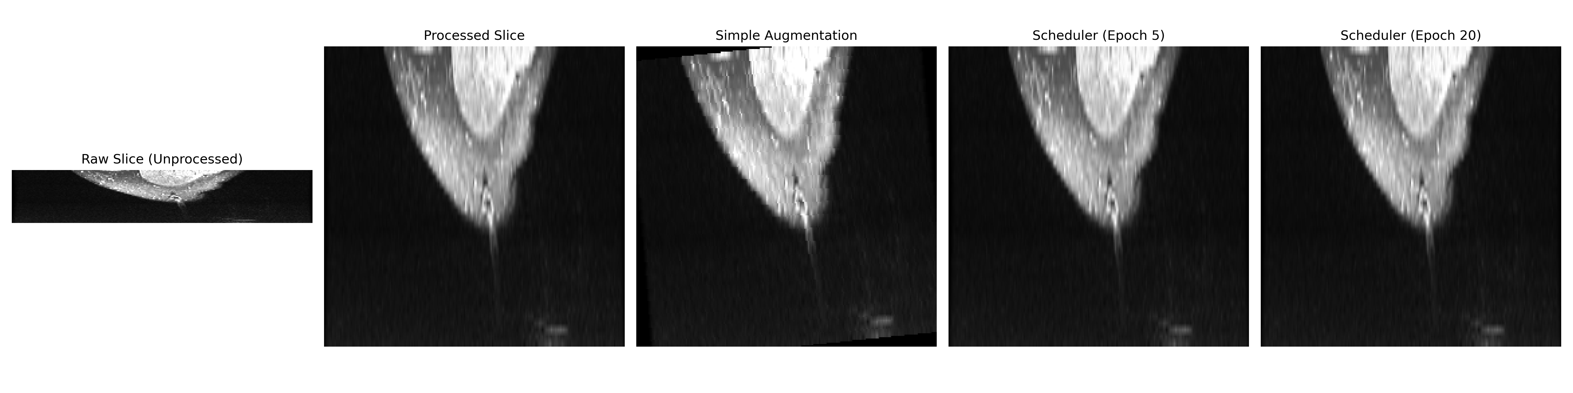
Data Augmentation Progression

Slide 11
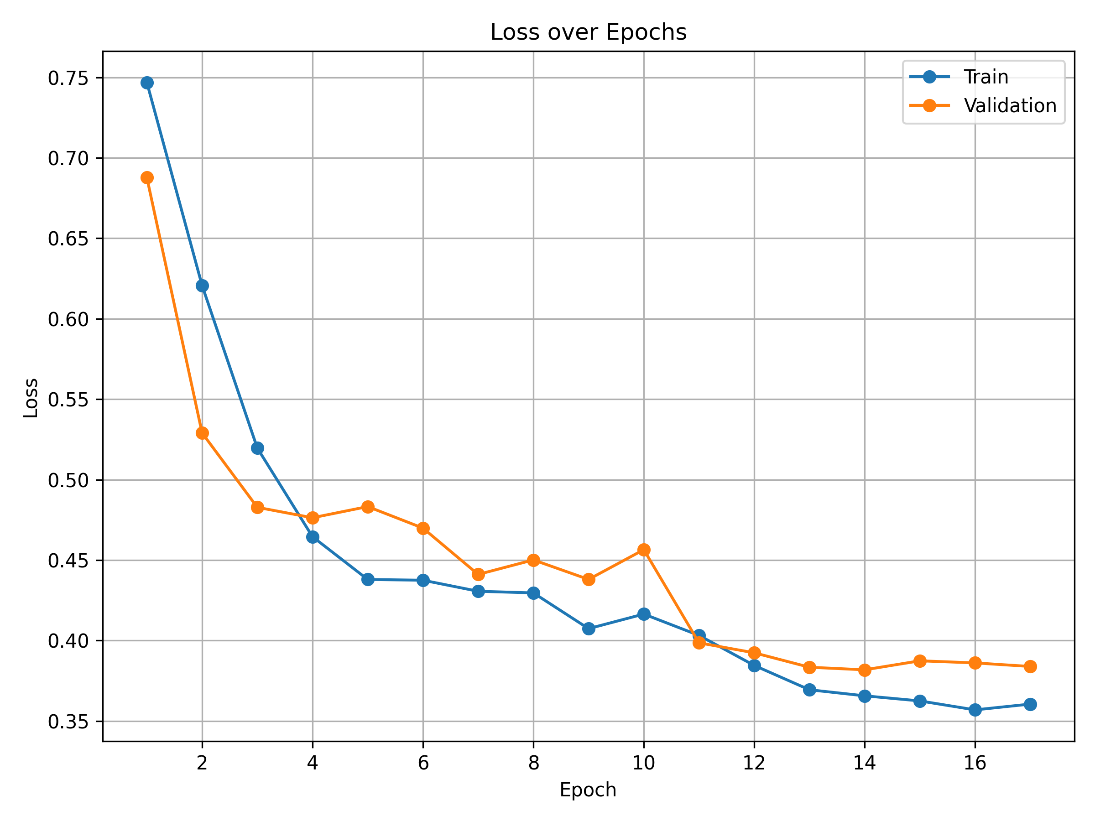
Loss/Validation Curves

Slide 12
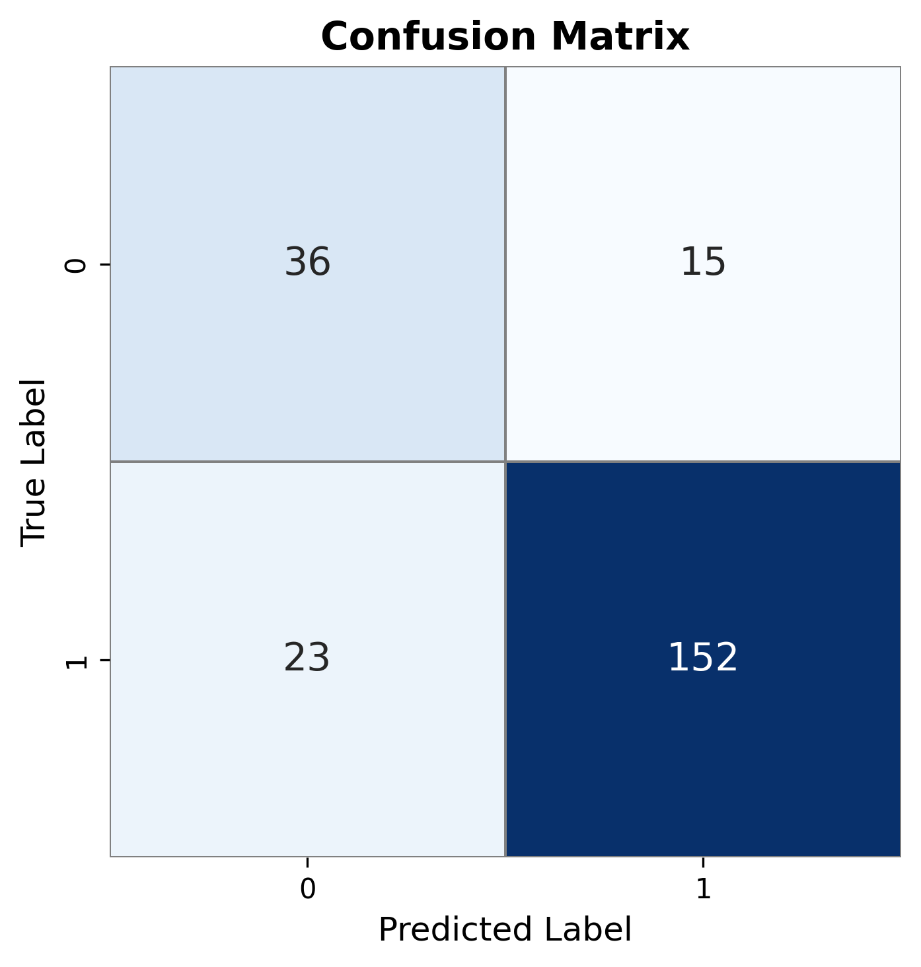

Slide 13
Experiments:
Data Aug Scheduler vs Simple Data Augmentation
Test AUC: 0.872 vs 0.874
Test Loss: 0.268 vs 0.266
Test Accuracy: 82.7% vs 80.5 %
Attention vs no-attention
Test AUC: 0.872 vs 0.854
Test Loss: 0.268 vs 0.431
Test Accuracy: 82.7% vs 77.8%

Slide 14
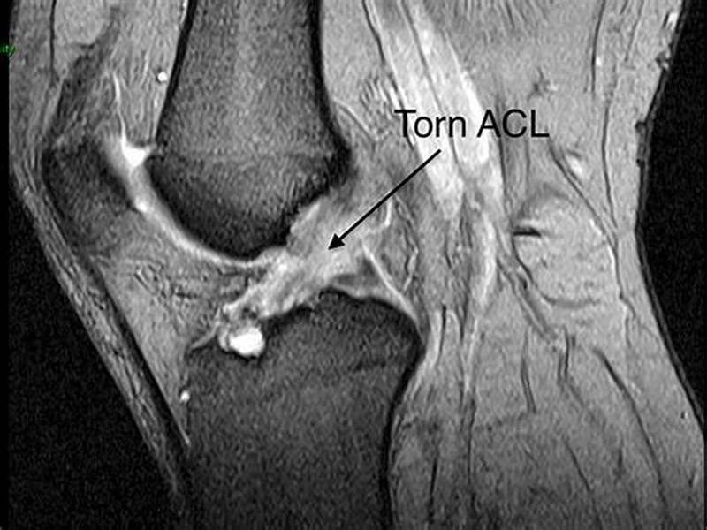
Conclusion and Lessons Learned
In summary, while the pipeline presented in this work achieved strong baseline performance, several promising avenues for improvement remain.
Completing the three-view ensemble
Incorporating full 3D spatial reasoning
Exploring medically pre-trained backbones
Further investigating our freeze and augmentation scheduler strategies
Lessons Learned:
Pipeline development must be tailored to the specific task and dataset.
No technique is universally optimal — every design choice must be evaluated in the context of the overall pipeline.
Each component (preprocessing, model architecture, training strategy) interacts with others, meaning changes to one step can impact the effectiveness of previous and future steps.

Slide 15
Sources
Nyúl L G, Udupa J K. On Standardizing the MR Image Intensity Scale. Magnetic Resonance in Medicine 42:1072-1081 (1999). doi:10.1002/(SICI)1522-2594(199912)42:6
Štajduhar I et al. Semi-Automated Detection of Anterior Cruciate Ligament Injury from MRI. Computer Methods and Programs in Biomedicine 140:151-164 (2017).
Mackenzie R, Palmer C R, Lomas D J, Dixon A K. Magnetic Resonance Imaging of the Knee: Diagnostic Performance Studies. Clinical Radiology 51 (4):251-257 (1996). doi:10.1016/S0009-9260(96)80341-2
Cheung L P et al. Meniscal Tears of the Knee: Accuracy of Detection with Fast Spin-Echo MRI and Arthroscopic Correlation in 293 Patients. Radiology 203 (2):508-512 (1997). doi:10.1148/radiology.203.2.9114113
Doi K. Computer-Aided Diagnosis in Medical Imaging: Historical Review, Current Status and Future Potential. Computerized Medical Imaging and Graphics 31 (4-5):198-211 (2007). doi:10.1016/j.compmedimag.2007.02.002
Elvenes J, Jerome C P, Reikerås O, Johansen O. MRI as a Screening Procedure to Avoid Arthroscopy for Meniscal Tears. Archives of Orthopaedic and Trauma Surgery 120 (1-2):14-16 (2000). doi:10.1007/PL00021235
Feller J A, Webster K E. Clinical Value of Magnetic Resonance Imaging of the Knee. ANZ Journal of Surgery 71 (9):534-537 (2001). doi:10.1046/j.1440-1622.2001.02183.x
Hong S H et al. Grading of Anterior Cruciate Ligament Injury: Diagnostic Efficacy of Oblique-Coronal MRI of the Knee. Journal of Computer Assisted Tomography 27 (5):814-819 (2003). doi:10.1097/00004728-200309000-00022
Litjens G et al. A Survey on Deep Learning in Medical Image Analysis. Medical Image Analysis 42:60-88 (2017). doi:10.1016/j.media.2017.07.005
Rizk B et al. Meniscal Lesion Detection and Characterization in Adult Knee MRI: A Deep Learning Model with External Validation. Physica Medica 83:64-71 (2021). doi:10.1016/j.ejmp.2021.02.010
Gulshan V et al. Development and Validation of a Deep Learning Algorithm for Detection of Diabetic Retinopathy in Retinal Fundus Photographs. JAMA 316 (22):2402-2410 (2016). doi:10.1001/jama.2016.17216
Golan R, Jacob C, Denzinger J. Lung Nodule Detection in CT Images Using Deep CNNs. Proc. IJCNN 2016:243-250. doi:10.1109/IJCNN.2016.7727205
Liu F et al. Deep Learning for Knee MRI: High Diagnostic Performance for Cartilage Lesion Detection. Radiology 289 (1):160-169 (2018). doi:10.1148/radiol.2018172986
McNally E G et al. Role of MRI in the Clinical Management of the Acutely Locked Knee. Skeletal Radiology 31 (10):570-573 (2002). doi:10.1007/s00256-002-0557-1
Etc. (listed on final report)
Acknowledgments: Dr. Santos, Stanford ML group

Slide 16
Questions???

Slide 17
END OF PRESENTATION: BELOW SLIDES ARE OPTION

Slide 18
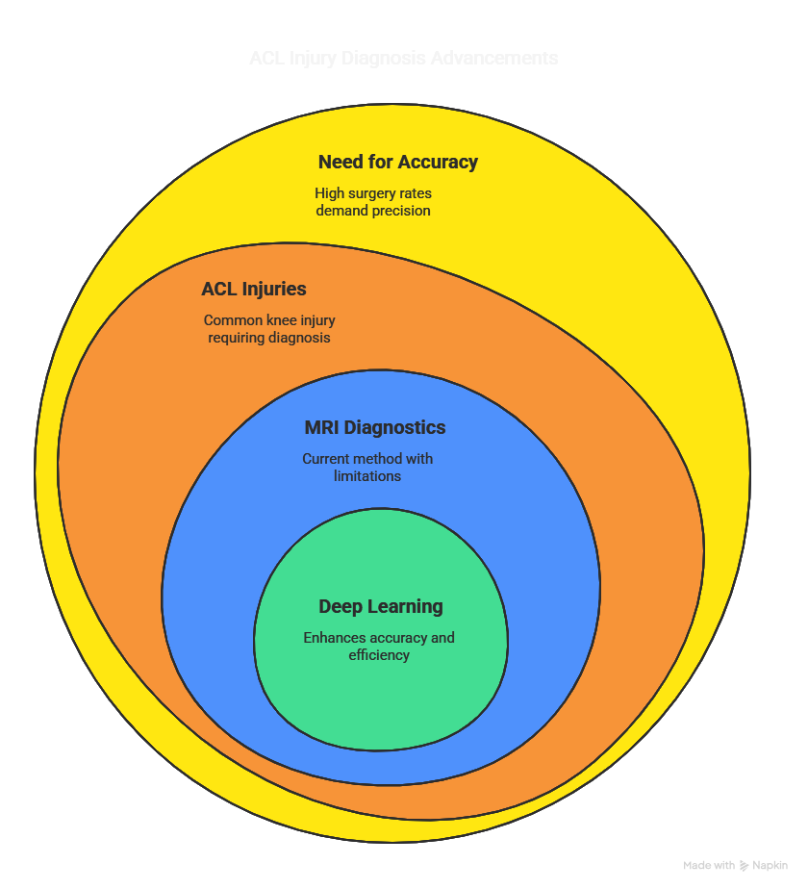

Slide 19
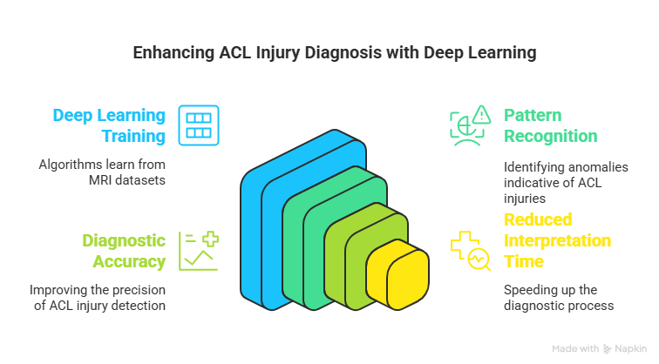
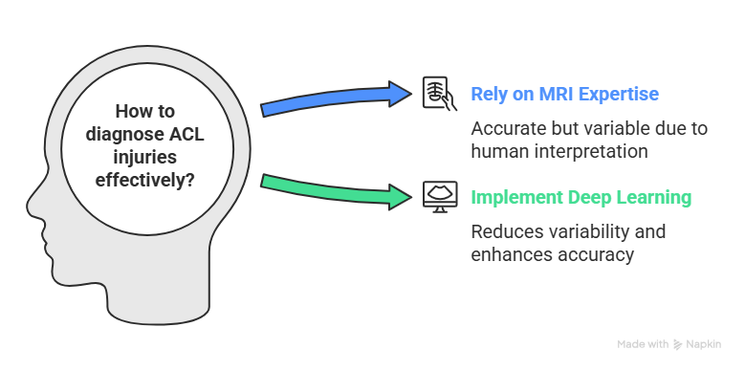
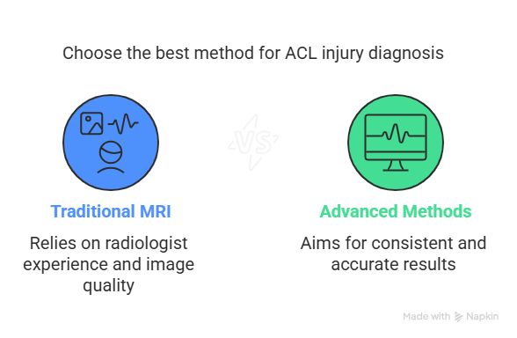
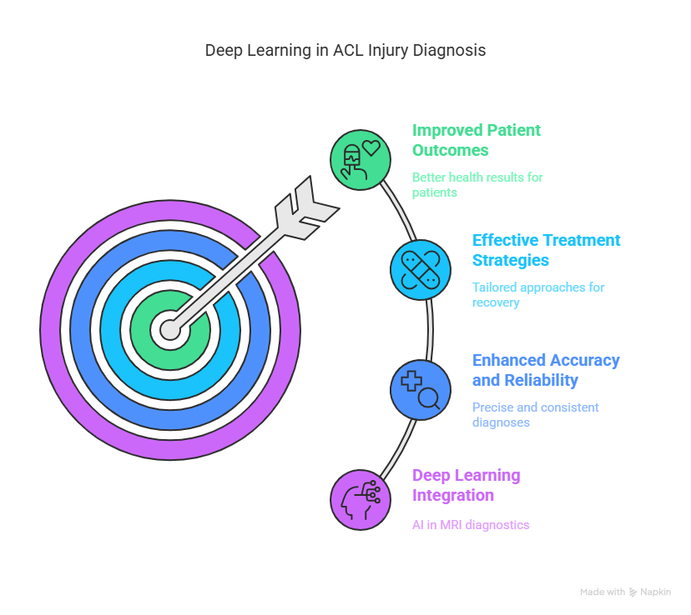

Slide 20
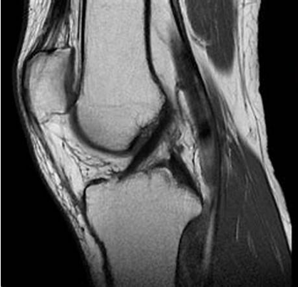
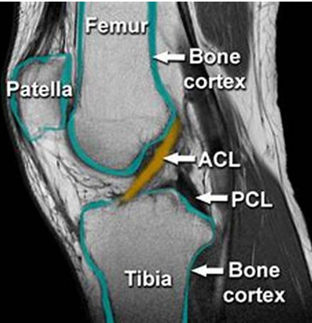
2.1: Dataset Description
Dataset Overview
The Stanford MRNet dataset includes 1,370 MRI scans from patients, providing diverse imaging orientations essential for analyzing ACL injuries effectively.
Labeling Significance
Each image is meticulously labeled to indicate ACL tear presence and severity, which is vital for training machine learning models and ensuring accurate evaluations.
Preprocessing Techniques
Advanced preprocessing methods, including slice standardization and normalization, were applied to enhance image quality and mitigate acquisition variability, improving model performance.

Slide 21
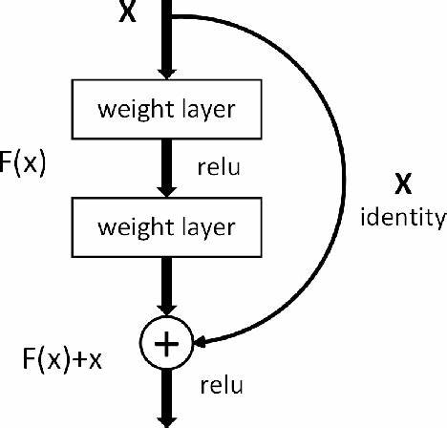
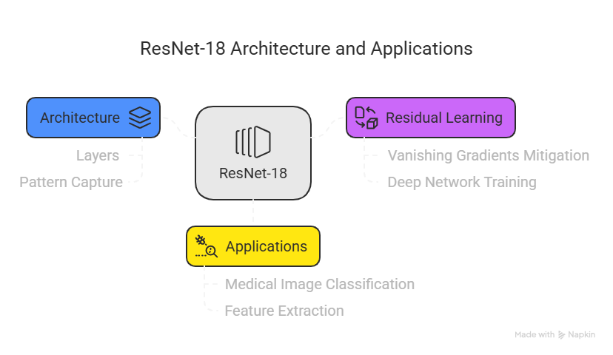
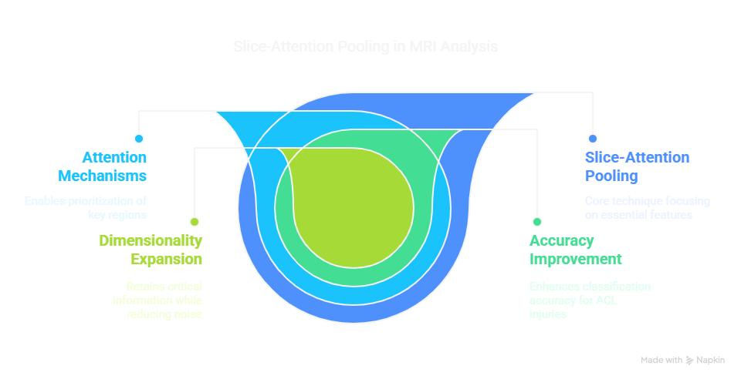
2.2 Model Architecture
ResNet-18 Integration
The ResNet-18 architecture, known for its deep learning capabilities, is enhanced with slice-attention pooling to improve focus on critical MRI features, facilitating accurate classification of ACL injuries through effective feature extraction and dimensionality expansion.

Slide 22
3.2 Discussion of Findings
Model Performance Insights
The integration of attention mechanisms and data augmentation not only improved AUC scores but also highlighted the model's potential to adapt to diverse clinical scenarios, emphasizing the need for ongoing refinement and validation in real-world applications.
3.3 Limitations and Future Work
Dataset Diversity Concerns
Limited dataset size may not represent all ACL injury variations, affecting model accuracy.
Preprocessing Technique Adaptability
Handcrafted preprocessing methods may hinder flexibility; automated techniques could enhance consistency and efficiency.
Model Architecture Limitations
ResNet-18 may not fully capture complexities of 3D MRI data, necessitating advanced architectures.

